Slide 1
P2-Hnefatafl
-Party A
Members(A-Z):
Emmett BeAney, Jacinda Li ,Miriam Alzamily, Nana Yin, Shrey Uday

Slide 2
The perfection of documents
1. User stories
2.CRC card & class diagram
3.Acceptance Criteria
4. Task for User stories
5. Development Manual
Picture Source: the picture from the network. https://zhuanlan.zhihu.com/p/33300643

Slide 3
User Stories

Slide 4

User Stories
1. As a user, I want to register to this platform by using an email, nickname and a password.
2. As a user, I want to login to this platform using the account I registered.
3. As a user, I want to be able to play Hnefatafl.
4. As a user, I want to know when it is my turn.
5. As a user, I want to be able to logout from my account when I do not want to play, and receive a prompt before it exits.

Slide 5
Move methods
Gameboard
int getCount()
boolean validPosition()
boolean validMove()
void move()
Match
String prompt()
Piece
String getColor()
String getPosition()
void setPosition()
ArrayList<String> legalMoves()

Slide 6
Task for User Stories
·As a user, I want to be able to play Hnefatafl.
Priority:1
Task:
1.Write code about basic game screen
2.Write code to achieve chess movement
3.Write code to achieve the chessmen eat the opponent's chessmen
4.Write code to achieve update game screen
5.Write code to achieve the logout button

Slide 7
Task for User Stories
• As a user, I want to know when it is my turn.
Priority:2
Task:
1.Write code to implement the round prompt interface
2.Write code to click on the screen space, the prompt screen automatically disappear

Slide 8
CRC Cards &
Class Diagram

Slide 9
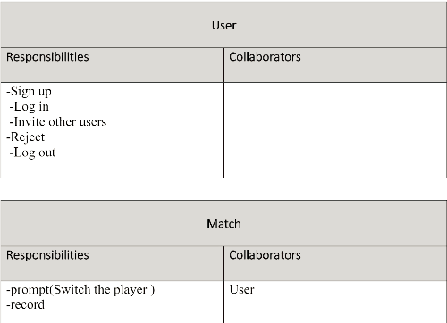
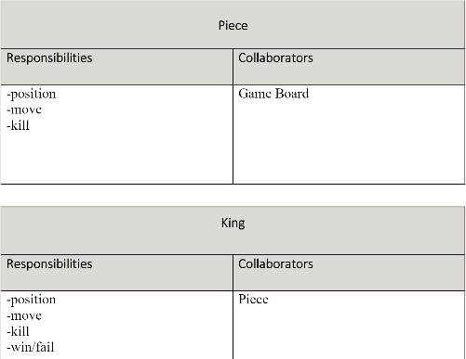
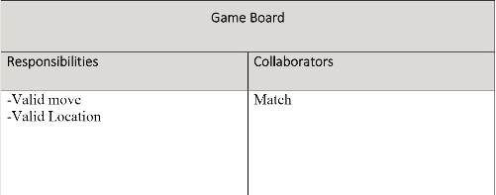
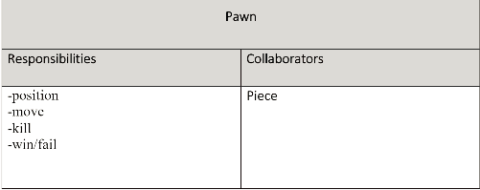
CRC Cards &Class Diagram

Slide 10
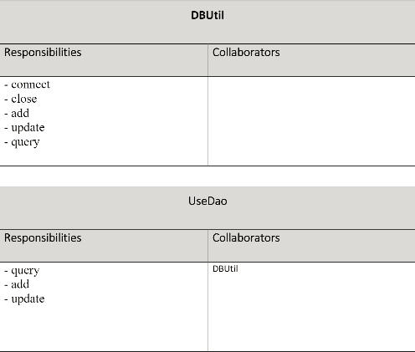
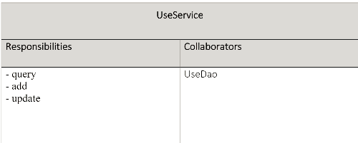
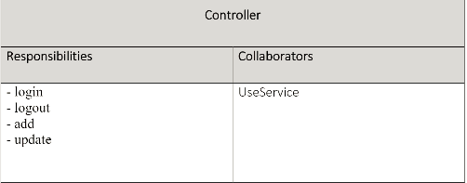
CRC Cards &Class Diagram

Slide 11
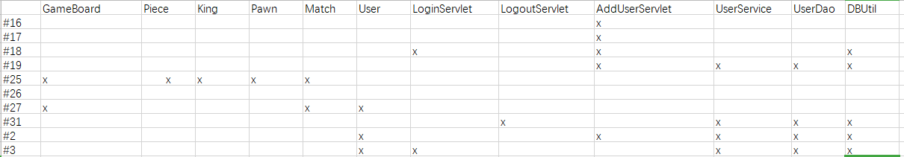
Ttaceability link martix

Slide 12
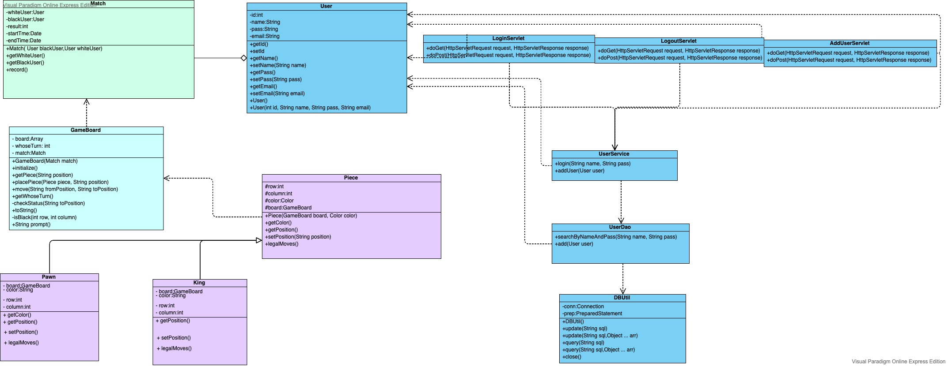
CRC Cards &Class Diagram

Slide 13
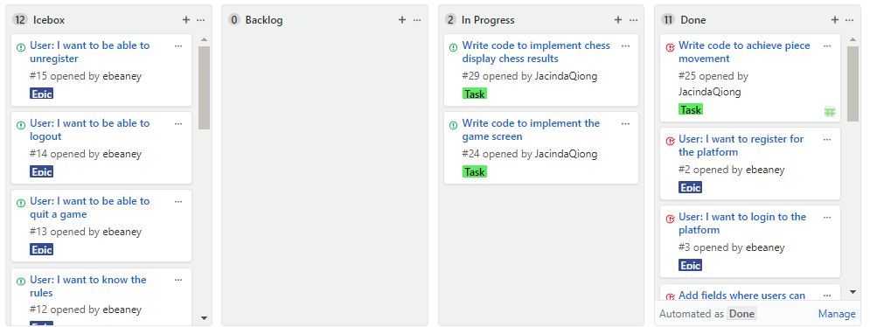
Kanban

Slide 14
Sprint Review
and Retrospective

Slide 15
Sprint Review and Retrospective
Daily scrums:
Disscussed progress
Review:
Went over results of sprint
Made changes as needed accotding to product owner
Retrospective:
Identified what could improve
Identified what went well

Slide 16
Sprint Review and Retrospective
10/11-During this scrum,we discussed the file content of P2 together and allocated the files within the file.
10/21-During this scrum,we asked the professor about the parts of the P1 document that could be improved.The task of file improvement was assigned.
10/24-During this scrum,together, we solved the game's implementation of the code logic for the round, assigned code tasks based on the improved task and each person's familiar direction, and worked out the deadline.
10/31-During this scrum, we integrated the code into a project.

Slide 17
Sprint Review and Retrospective
What went well:
Our scrum meetings discussed a lot of details about the implementation of the game, actively assigning tasks, making plans for each week and the next meeting time.
What could improve:
1.The task should smaller and clearer,a voiding two pwowplw spending time on similar function
2. Need more effective communication during our team meeting
3. Everyone must strictl abide by the deadline,and deliver the outcomes on times.

Slide 18
THANK YOU FOR WATCHING

